Slide 1
Java Script

Slide 2
JavaScript (js) is a light-weight object-oriented programming language which is used by several websites for scripting the webpages.
It is an interpreted, full-fledged programming language that enables dynamic interactivity on websites when applied to an HTML document.
It was introduced in the year 1995 for adding programs to the webpages in the Netscape Navigator browser.

Slide 3
Features of JavaScript
All popular web browsers support JavaScript as they provide built-in execution environments.
JavaScript follows the syntax and structure of the C programming language. Thus, it is a structured programming language.
JavaScript is a weakly typed language, where certain types are implicitly cast (depending on the operation).
JavaScript is an object-oriented programming language that uses prototypes rather than using classes for inheritance.

Slide 4
It is a light-weighted and interpreted language.
It is a case-sensitive language.
JavaScript is supportable in several operating systems including, Windows, macOS, etc.
It provides good control to the users over the web browsers.

Slide 5
Application of JavaScript
JavaScript is used to create interactive websites. It is mainly used for:
Client-side validation,
Dynamic drop-down menus,
Displaying date and time,
Displaying pop-up windows and dialog boxes (like an alert dialog box, confirm dialog box and prompt dialog box),
Displaying clocks etc.

Slide 6
JavaScript Example
Javascript example is easy to code. JavaScript provides 3 places to put the JavaScript code: within body tag, within head tag and external JavaScript file.
Let’s create the first JavaScript example.
<script type="text/javascript">
document.write("JavaScript is a simple language for javatpoint learners");
</script>

Slide 7
The script tag specifies that we are using JavaScript.
The text/javascript is the content type that provides information to the browser about the data.
The document.write() function is used to display dynamic content through JavaScript

Slide 8
3 Places to put JavaScript code
Between the body tag of html
Between the head tag of html
In .js file (external javaScript)
1) JavaScript Example : code between the body tag
<script type="text/javascript">
alert("Hello Javatpoint");
</script>

Slide 9
2) JavaScript Example : code between the head tag
<html>
<head>
<script type="text/javascript">
function msg(){
alert("Hello Javatpoint");
}
</script>
</head>
<body>
<p>Welcome to JavaScript</p>
<form>
<input type="button" value="click" onclick="msg()"/>
</form>
</body>
</html>

Slide 10
External JavaScript file
We can create external JavaScript file and embed it in many html page.
It provides code re usability because single JavaScript file can be used in several html pages.
An external JavaScript file must be saved by .js extension. It is recommended to embed all JavaScript files into a single file. It increases the speed of the webpage.

Slide 11
message.js
function msg(){
alert("Hello CS2YR");
}
Let's include the JavaScript file into html page. It calls the JavaScript function on button click.

Slide 12
index.html
<html>
<head>
<script type="text/javaScript" src="message.js"></script>
</head>
<body>
<p>Welcome to JavaScript</p>
<form>
<input type="button" value="click" onclick="msg()"/>
</form>
</body>
</html>

Slide 13
Advantages of External JavaScript
It helps in the reusability of code in more than one HTML file.
It allows easy code readability.
It is time-efficient as web browsers cache the external js files, which further reduces the page loading time.
It enables both web designers and coders to work with html and js files parallelly and separately, i.e., without facing any code conflictions.
The length of the code reduces as only we need to specify the location of the js file.

Slide 14
JavaScript Comment
Types of JavaScript Comments
There are two types of comments in JavaScript.
Single-line Comment
Multi-line Comment
<script>
// It is single line comment
document.write("hello javascript");
</script>

Slide 15
<script>
/* It is multi line comment.
It will not be displayed */
document.write("example of javascript multiline comment");
</script>

Slide 16
JavaScript Variable
A JavaScript variable is simply a name of storage location. There are two types of variables in JavaScript : local variable and global variable.
There are some rules while declaring a JavaScript variable (also known as identifiers).
Name must start with a letter (a to z or A to Z), underscore( _ ), or dollar( $ ) sign.
After first letter we can use digits (0 to 9), for example value1.
JavaScript variables are case sensitive, for example x and X are different variables.

Slide 17
Correct JavaScript variables
var x = 10;
var _value="sonoo";
Incorrect JavaScript variables
var 123=30;
var *aa=320;
JavaScript local variable: A JavaScript local variable is declared inside block or function. It is accessible within the function or block only. For example:

Slide 18
<script>
function abc(){
var x=10;//local variable
}
</script>

Slide 19
JavaScript global variable
A JavaScript global variable is accessible from any function. A variable i.e. declared outside the function or declared with window object is known as global variable. For example:
<script>
var data=200;//gloabal variable
function a(){
document.writeln(data);
}
function b(){
document.writeln(data);
}
a();//calling JavaScript function
b();
</script>

Slide 20
A JavaScript global variable is declared outside the function or declared with window object. It can be accessed from any function.
<script>
var value=50;//global variable
function a(){
alert(value);
}
function b(){
alert(value);
}
</script>

Slide 21
Declaring JavaScript global variable within function
To declare JavaScript global variables inside function, you need to use window object.
function m(){
window.value=100;//declaring global variable by window object
}
function n(){
alert(window.value);//accessing global variable from other function
}

Slide 22
Internals of global variable in JavaScript
When you declare a variable outside the function, it is added in the window object internally. You can access it through window object also. For example:
var value=50;
function a(){
alert(window.value);//accessing global variable
}

Slide 23
Javascript Data Types
JavaScript provides different data types to hold different types of values. There are two types of data types in JavaScript.
Primitive data type
Non-primitive (reference) data type
JavaScript is a dynamic type language, means you don't need to specify type of the variable because it is dynamically used by JavaScript engine. You need to use var here to specify the data type. It can hold any type of values such as numbers, strings etc. For example:
var a=40;//holding number
var b="Rahul";//holding string

Slide 24
There are five types of primitive data types in JavaScript.
String
Number
Boolean
Undefined
Null

Slide 25
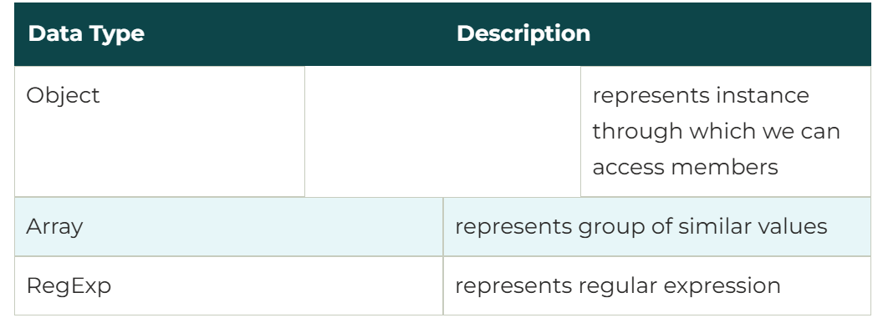
JavaScript non-primitive data types

Slide 26
JavaScript Operators
There are following types of operators in JavaScript.
Arithmetic Operators
Comparison (Relational) Operators
Bitwise Operators
Logical Operators
Assignment Operators
Special Operators

Slide 27
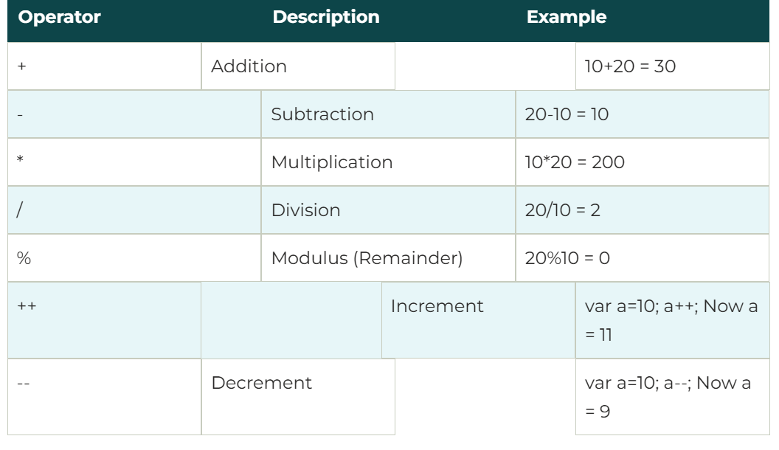

Slide 28
Conditional Statements
In JavaScript we have the following conditional statements:
Use if to specify a block of code to be executed, if a specified condition is true
Use else to specify a block of code to be executed, if the same condition is false
Use else if to specify a new condition to test, if the first condition is false
Use switch to specify many alternative blocks of code to be executed

Slide 29
The if Statement
Use the if statement to specify a block of JavaScript code to be executed if a condition is true.
if (condition) {
// block of code to be executed if the condition is true
}
The else Statement
Use the else statement to specify a block of code to be executed if the condition is false.

Slide 30
Use the else statement to specify a block of code to be executed if the condition is false.
if (condition) {
// block of code to be executed if the condition is true
} else {
// block of code to be executed if the condition is false
}

Slide 31
The else if Statement
Use the else if statement to specify a new condition if the first condition is false.
if (condition1) {
// block of code to be executed if condition1 is true
} else if (condition2) {
// block of code to be executed if the condition1 is false and condition2 is true
} else {
// block of code to be executed if the condition1 is false and condition2 is false
}

Slide 32
<!DOCTYPE html>
<html>
<body>
<h2>JavaScript if .. else</h2>
<p>A time-based greeting:</p>
<p id="demo"></p>
<script>
const time = new Date().getHours();
let greeting;
if (time < 10) {
greeting = "Good morning";
} else if (time < 20) {
greeting = "Good day";
} else {
greeting = "Good evening";
}
document.getElementById("demo").innerHTML = greeting;
</script>
</body>
</html>

Slide 33
JavaScript Switch Statement
The switch statement is used to perform different actions based on different conditions.
switch(expression) {
case x:
// code block
break;
case y:
// code block
break;
default:
// code block
}
The switch statement is fall-through i.e. all the cases will be evaluated if you don't use break statement.

Slide 34
JavaScript Loops
The JavaScript loops are used to iterate the piece of code using for, while, do while or for-in loops. It makes the code compact. It is mostly used in array.
There are four types of loops in JavaScript.
for loop
while loop
do-while loop
for-in loop

Slide 35
1) JavaScript For loop
The JavaScript for loop iterates the elements for the fixed number of times. It should be used if number of iteration is known. The syntax of for loop is given below.
for (initialization; condition; increment)
{
code to be executed
}

Slide 36
2) JavaScript while loop
The JavaScript while loop iterates the elements for the infinite number of times. It should be used if number of iteration is not known. The syntax of while loop is given below.
while (condition)
{
code to be executed
}

Slide 37
3) JavaScript do while loop
The JavaScript do while loop iterates the elements for the infinite number of times like while loop. But, code is executed at least once whether condition is true or false. The syntax of do while loop is given below.
do{
code to be executed
}while (condition);

Slide 38
JavaScript Functions
JavaScript functions are used to perform operations. We can call JavaScript function many times to reuse the code.
Advantage of JavaScript function
There are mainly two advantages of JavaScript functions.
Code reusability: We can call a function several times so it save coding.
Less coding: It makes our program compact. We don’t need to write many lines of code each time to perform a common task.

Slide 39
JavaScript Function Syntax
The syntax of declaring function is given below.
function functionName([arg1, arg2, ...argN]){
//code to be executed
}

Slide 40
JavaScript Function Example
Let’s see the simple example of function in JavaScript that does not has arguments.
<script>
function msg(){
alert("hello! this is message");
}
</script>
<input type="button" onclick="msg()" value="call function"/>

Slide 41
Function Return
When JavaScript reaches a return statement, the function will stop executing.
If the function was invoked from a statement, JavaScript will "return" to execute the code after the invoking statement.
Functions often compute a return value. The return value is "returned" back to the "caller":

Slide 42
<!DOCTYPE html>
<html>
<body>
<h1>JavaScript Functions</h1>
<p>Call a function which performs a calculation and returns the result:</p>
<p id="demo"></p>
<script>
let x = myFunction(4, 3);
document.getElementById("demo").innerHTML = x;
function myFunction(a, b) {
return a * b;
}
</script>
</body>
</html>

Slide 43
The Function() Constructor
JavaScript functions are defined with the function keyword.
Functions can also be defined with a built-in JavaScript function constructor called Function().

Slide 44
<!DOCTYPE html>
<html>
<body>
<h2>JavaScript Functions</h2>
<p>JavaScript has an built-in function constructor.</p>
<p id="demo"></p>
<script>
const myFunction = new Function("a", "b", "return a * b");
document.getElementById("demo").innerHTML = myFunction(4, 3);
</script>
</body>
</html>

Slide 45
JavaScript Function Parameters
A JavaScript function does not perform any checking on parameter values (arguments).
function functionName(parameter1, parameter2, parameter3) {
// code to be executed
}
Function parameters are the names listed in the function definition.
Function arguments are the real values passed to (and received by) the function.

Slide 46
Parameter Rules
JavaScript function definitions do not specify data types for parameters.
JavaScript functions do not perform type checking on the passed arguments.
JavaScript functions do not check the number of arguments received.
Default Parameters:
If a function is called with missing arguments (less than declared), the missing values are set to undefined.
Sometimes this is acceptable, but sometimes it is better to assign a default value to the parameter:

Slide 47
example
<!DOCTYPE html>
<html>
<body>
<p>Setting a default value to a function parameter.</p>
<p id="demo"></p>
<script>
function myFunction(x, y) {
if (y === undefined) {
y = 2;
}
return x * y;
}
document.getElementById("demo").innerHTML = myFunction(4);
</script>
</body>
</html>

Slide 48
Function Rest Parameter
The rest parameter (...) allows a function to treat an indefinite number of arguments as an array:
Example
function sum(...args) {
let sum = 0;
for (let arg of args) sum += arg;
return sum;
}
let x = sum(4, 9, 16, 25, 29, 100, 66, 77);

Slide 49
JavaScript Function Invocation
Invoking a Function as a Function:
function myFunction(a, b) {
return a * b;
}
myFunction(10, 2); // Will return 20
Try it Yourself »

Slide 50
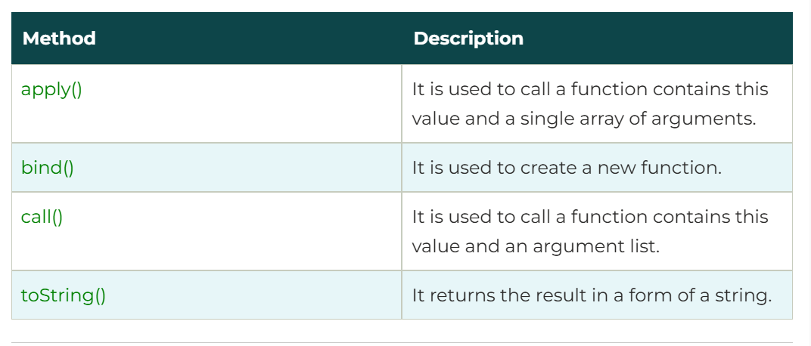
JavaScript Function Methods

Slide 51
JavaScript Objects
JavaScript Objects
A javaScript object is an entity having state and behavior (properties and method). For example: car, pen, bike, chair, glass, keyboard, monitor etc.
JavaScript is an object-based language. Everything is an object in JavaScript.
JavaScript is template based not class based. Here, we don't create class to get the object. But, we direct create objects.

Slide 52
Creating Objects in JavaScript:
There are 3 ways to create objects.
By object literal
By creating instance of Object directly (using new keyword)
By using an object constructor (using new keyword)

Slide 53
1) JavaScript Object by object literal
The syntax of creating object using object literal is given below:
object={property1:value1,property2:value2.....propertyN:valueN}
As you can see, property and value is separated by : (colon).
Let’s see the simple example of creating object in JavaScript.
<script>
emp={id:102,name:"Shyam Kumar",salary:40000}
document.write(emp.id+" "+emp.name+" "+emp.salary);
</script>

Slide 54
2) By creating instance of Object
The syntax of creating object directly is given below:
var objectname=new Object();
Here, new keyword is used to create object.
<script>
var emp=new Object();
emp.id=101;
emp.name="Ravi Malik";
emp.salary=50000;
document.write(emp.id+" "+emp.name+" "+emp.salary);
</script>

Slide 55
3) By using an Object constructor
Here, you need to create function with arguments. Each argument value can be assigned in the current object by using this keyword.
The this keyword refers to the current object.
<script>
function emp(id,name,salary){
this.id=id;
this.name=name;
this.salary=salary;
}
e=new emp(103,"Vimal Jaiswal",30000);
document.write(e.id+" "+e.name+" "+e.salary);
</script>

